Slide 1
Cloud Computing

Slide 2
Learning Objective
At the end of the training, you will be able to:
Identify Cloud Network and Cloud Storage Technologies
Comprehend Cloud design and Apply Cloud principles
Outline Benefits and Solutions of Cloud Services
Operate in the cloud environment
Compare and suggest cloud migration approaches
Identify Cloud Security Concerns and measures
Manage Policies and Procedures for Cloud Services

Slide 3
Agenda
Introduction to Cloud Computing Concepts
Cloud Network and Cloud Storage Technologies
Cloud Assessments and Services
Cloud Migration Approaches
Cloud Operations
Cloud Security and Risk Management Concepts
Policies, Procedures and Governance

Slide 4

Emerging Technologies for Web 3.0
Internet of Thing | Industrial IOT (IIOT) | Consumer IOT
Cloud Computing | Green Computing | Quantum computing
Data | BigData | Data Warehousing | Data Mining
Artificial Intelligence | Machine Learning | Deep Learning
Digital Marketing | SEO | SMM
Robotics Process Automation (RPA)
Virtual Reality | Augmented Reality | Mixed Reality
Blockchain
Industry 4.0

Slide 5
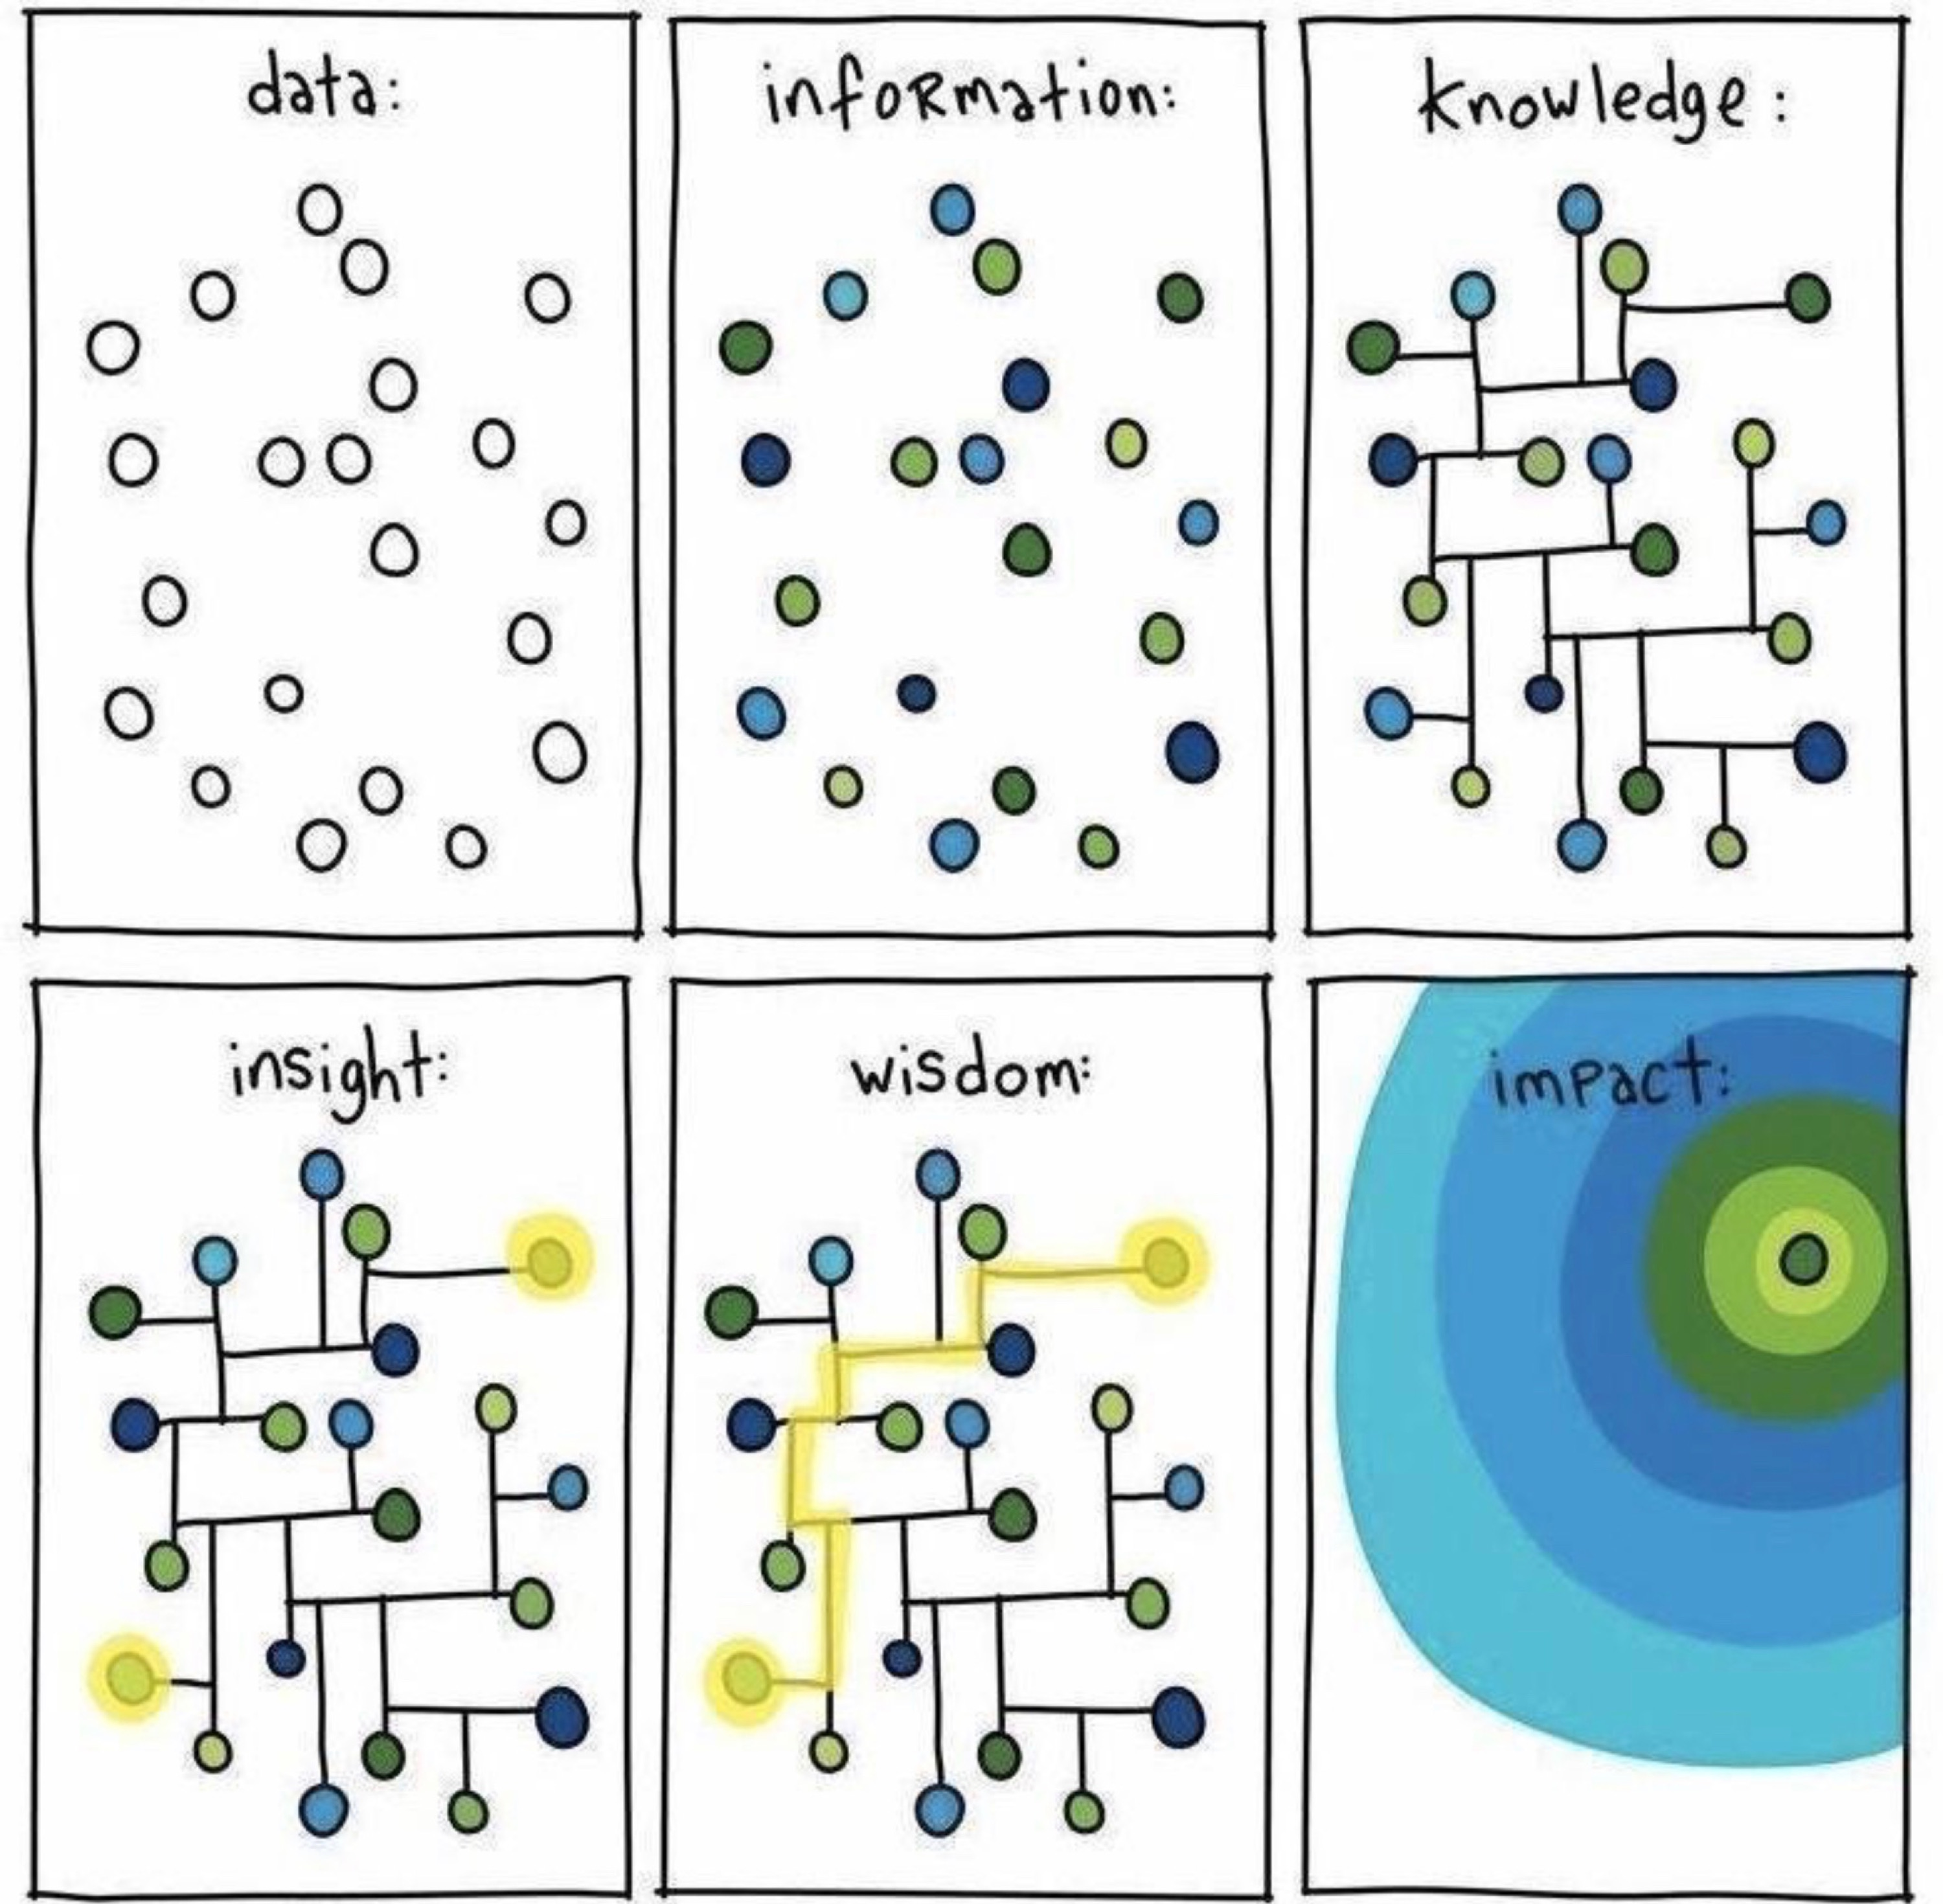
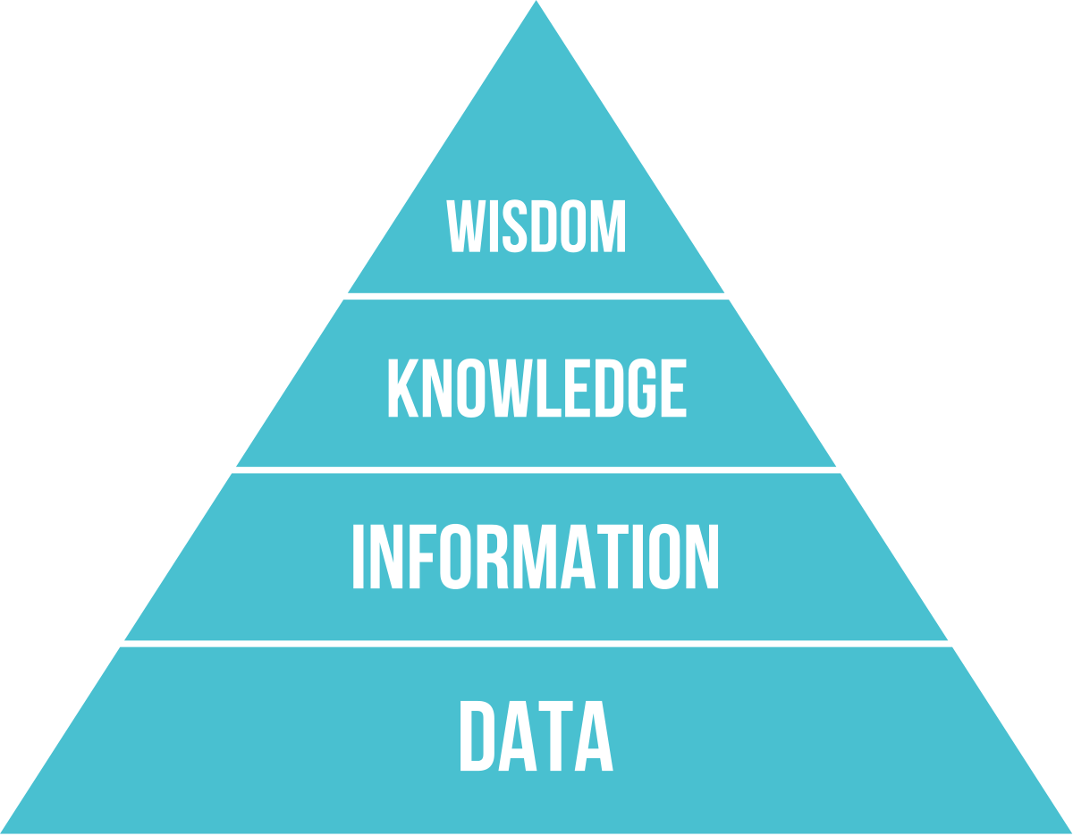


Slide 6
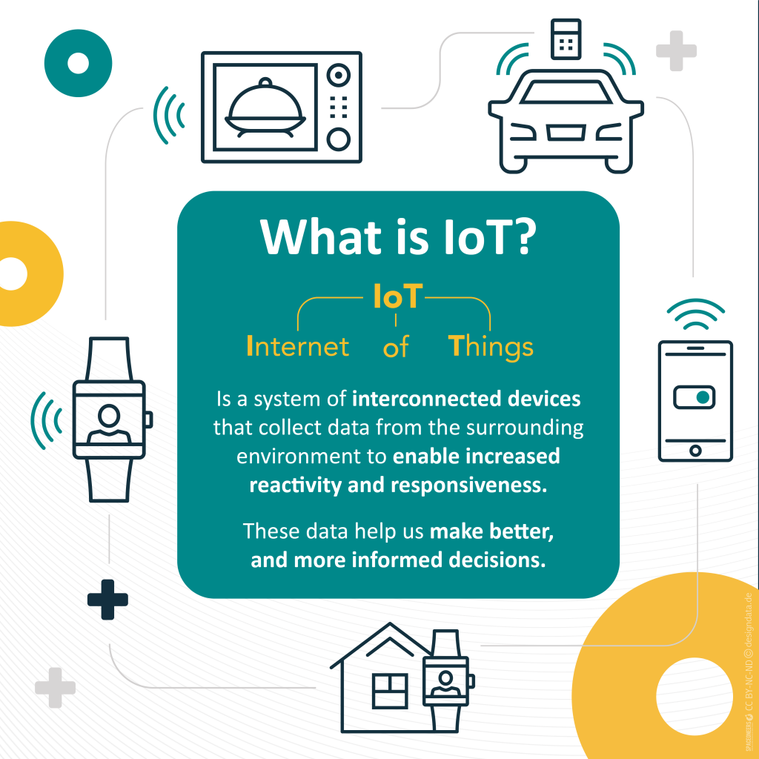
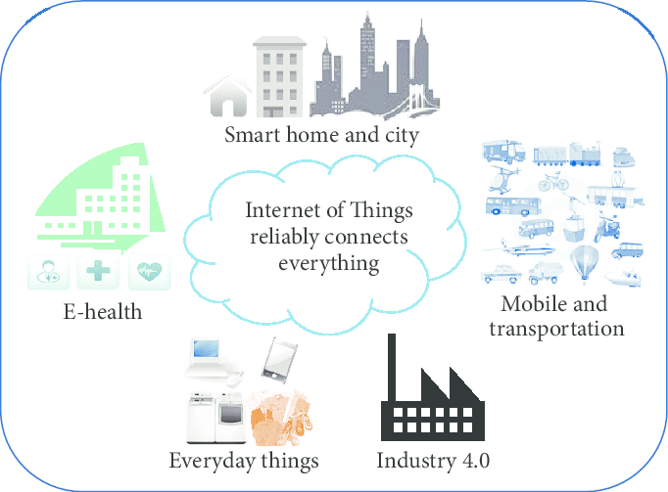

Slide 7
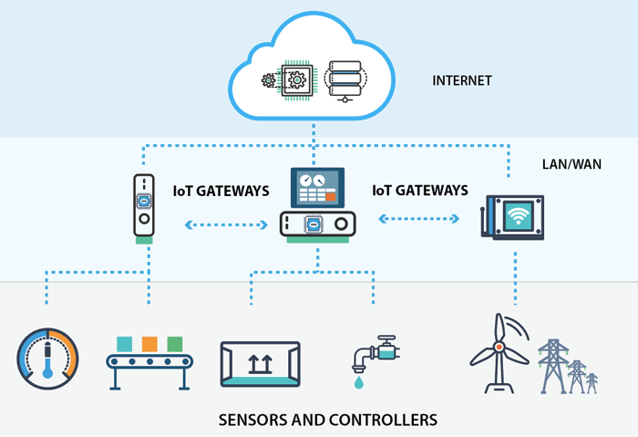
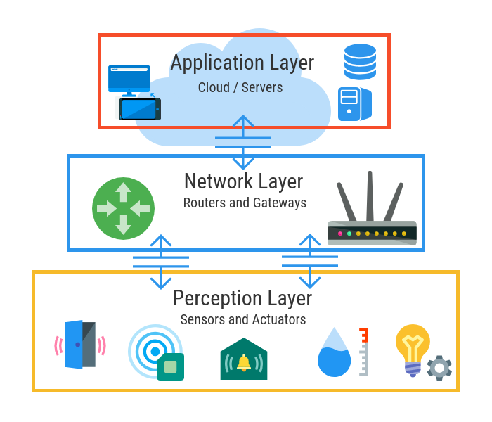
IOT Architecture

Slide 8
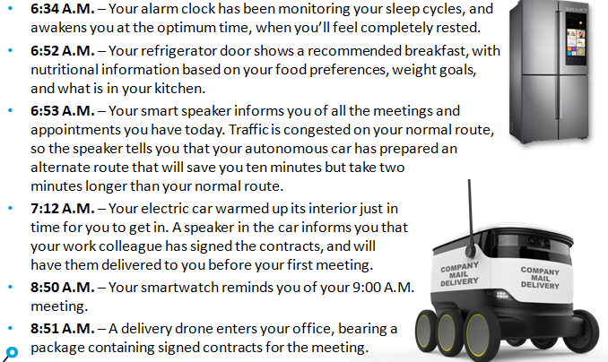

Slide 9
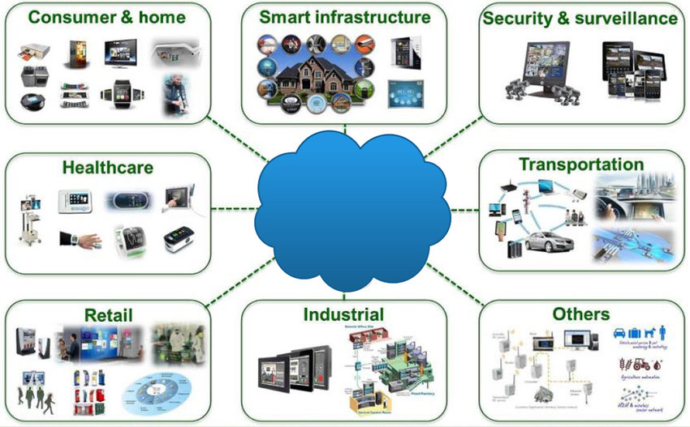
IOT Applications

Slide 10
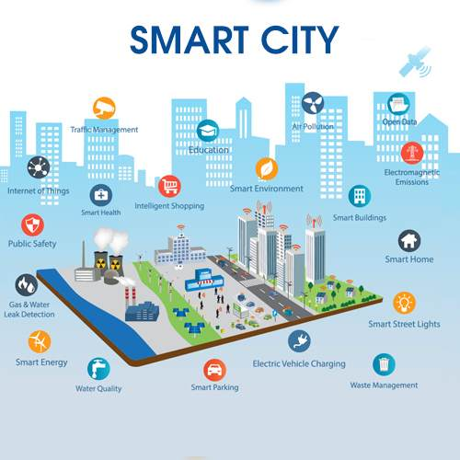

Slide 11
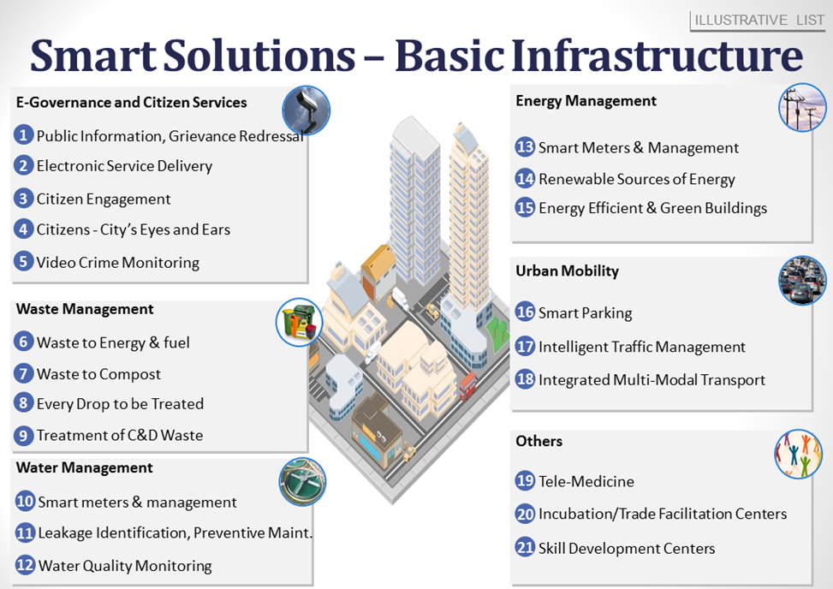

Slide 12
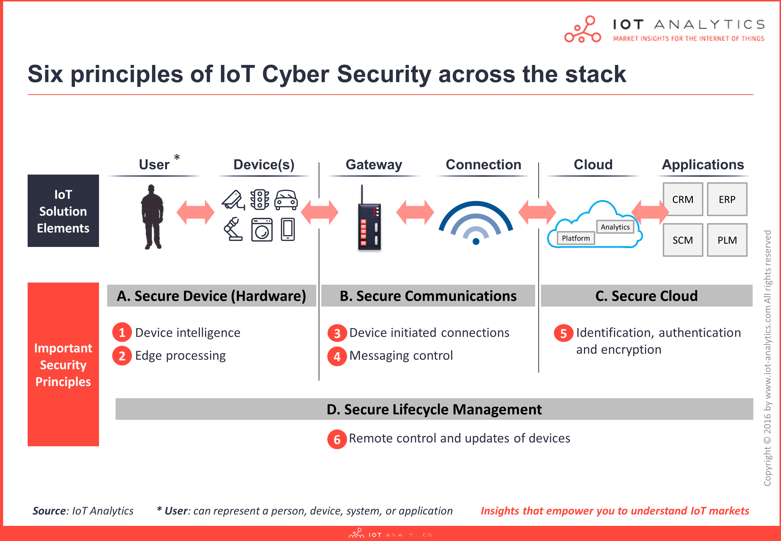
IOT Security

Slide 13
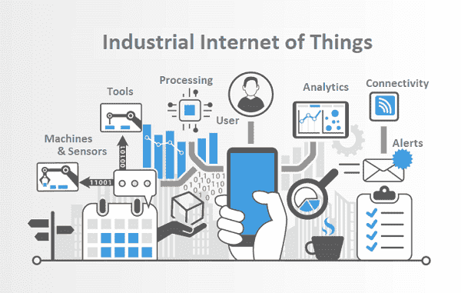
Industrial IOT

Slide 14
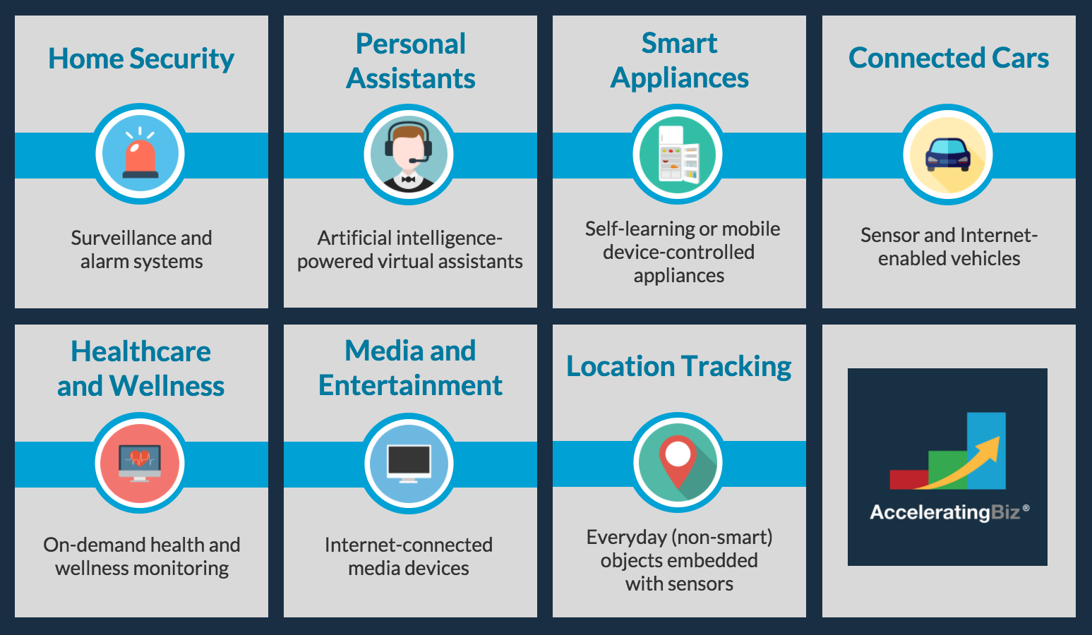
Consumer IOT

Slide 15
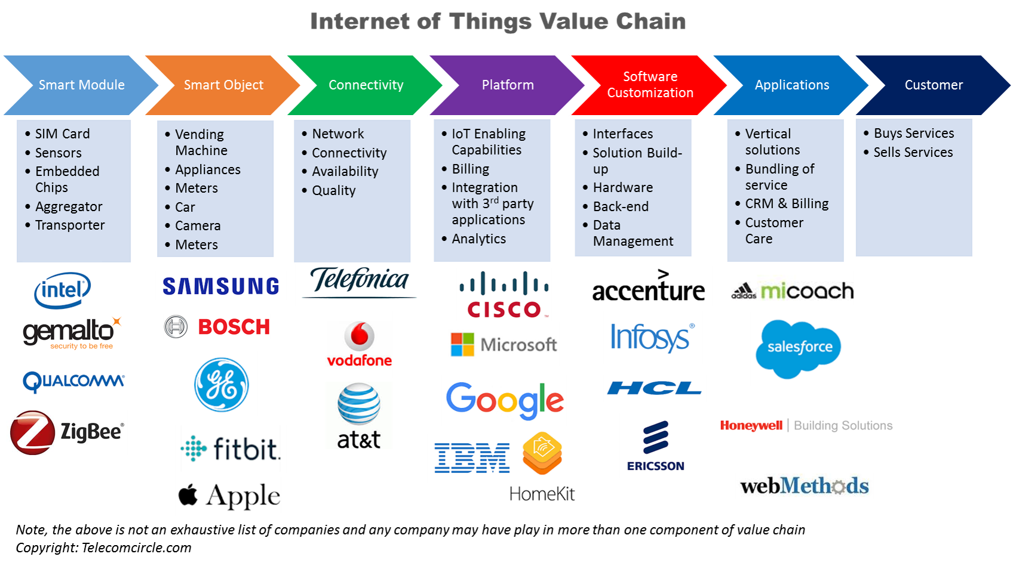
Business Applications

Slide 16
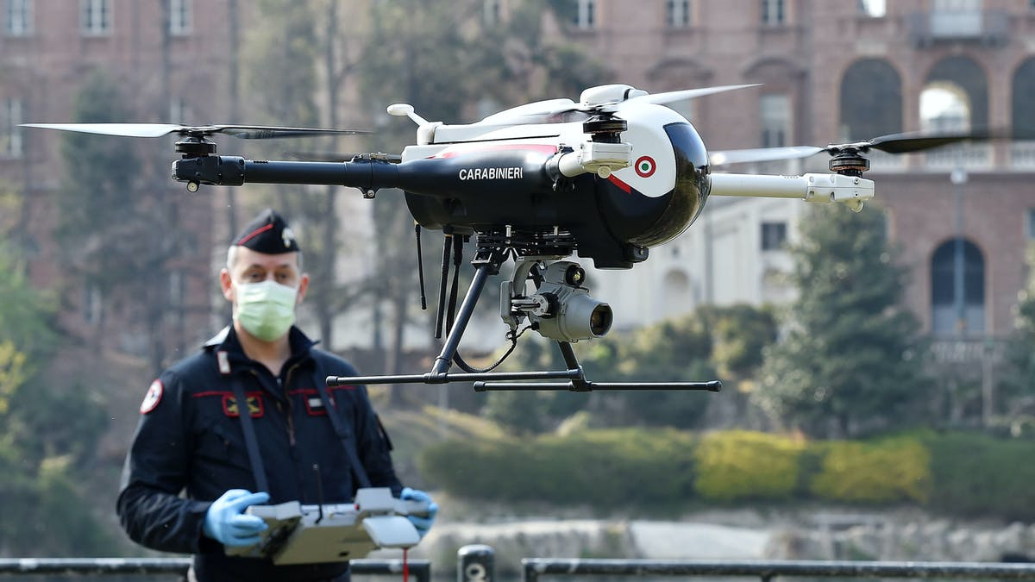
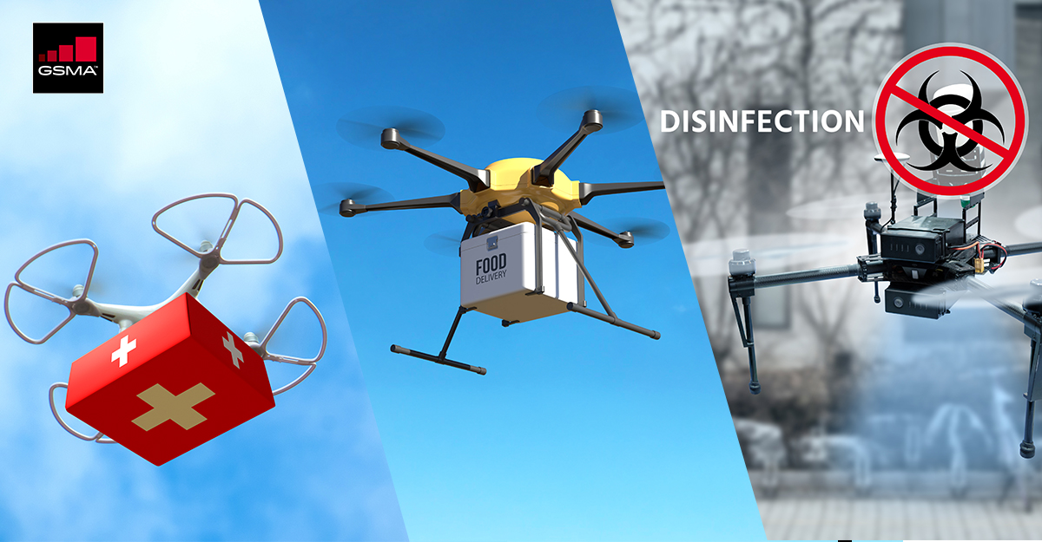
IOT in COVID19

Slide 17
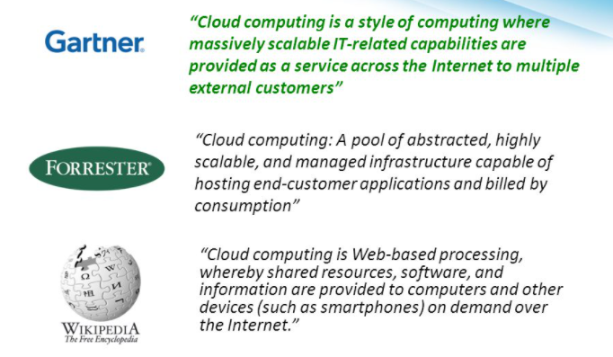
Cloud computing

Slide 18
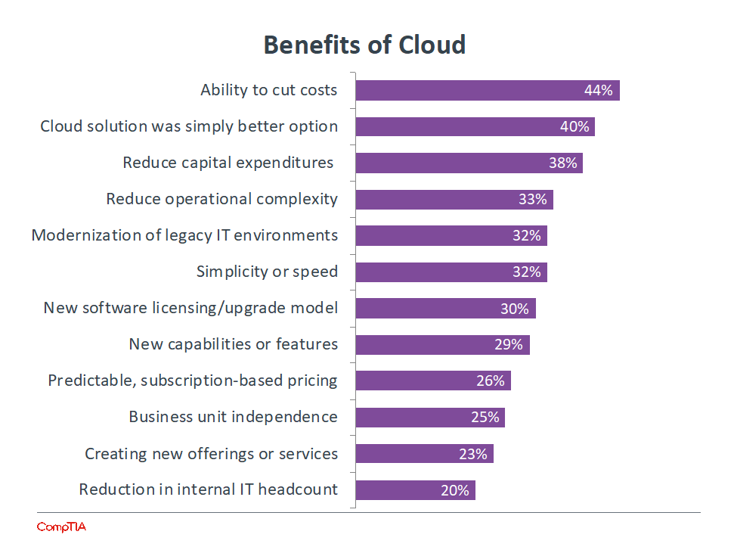

Slide 19
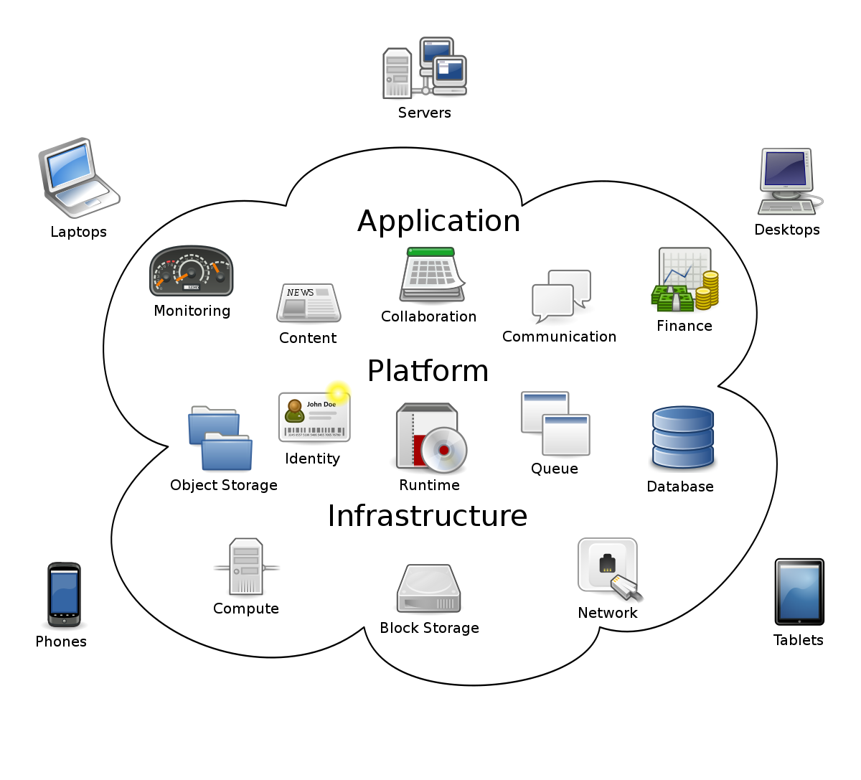

Slide 20
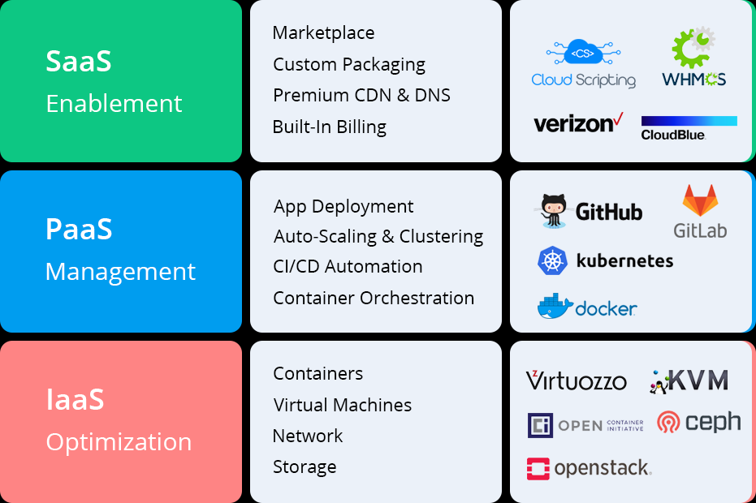
Cloud Computing Layers

Slide 21
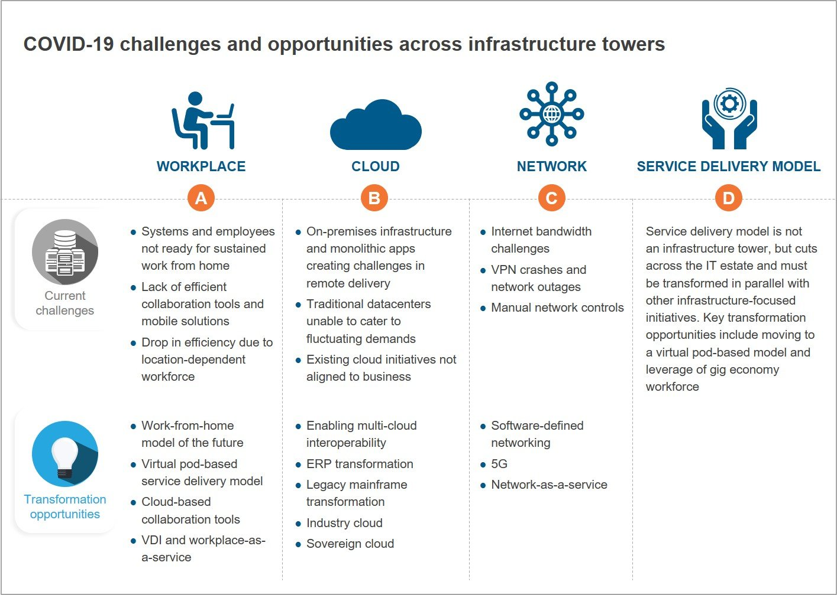

Slide 22
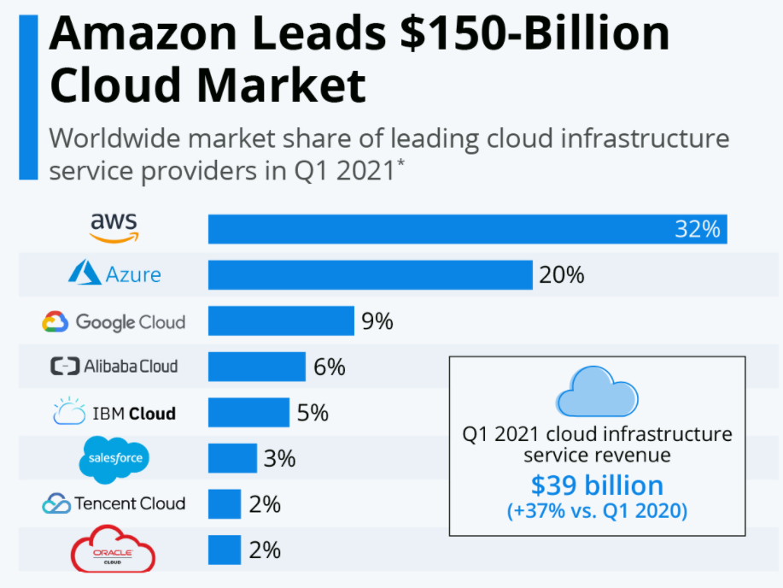
Cloud Vendors

Slide 23
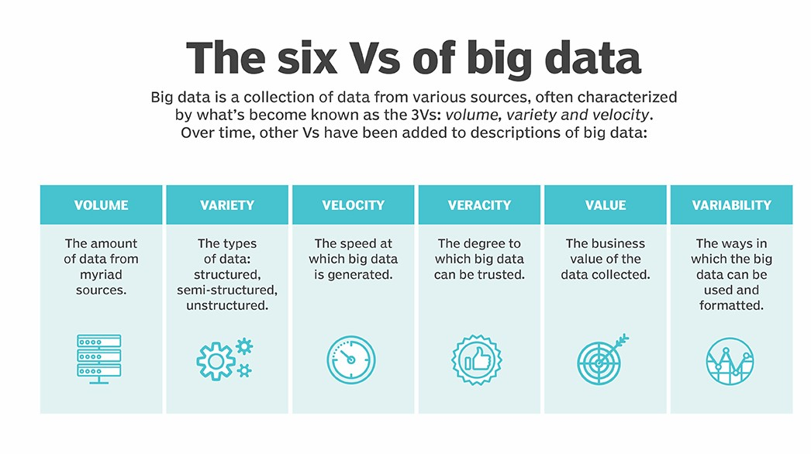
BigData

Slide 24
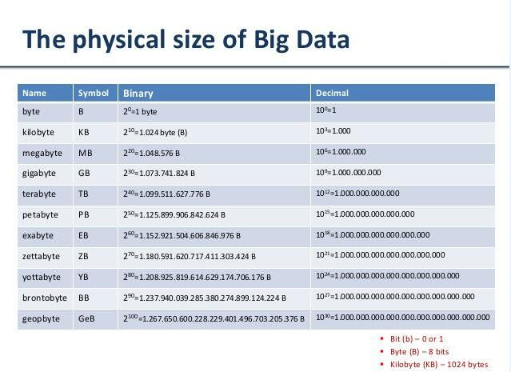

Slide 25
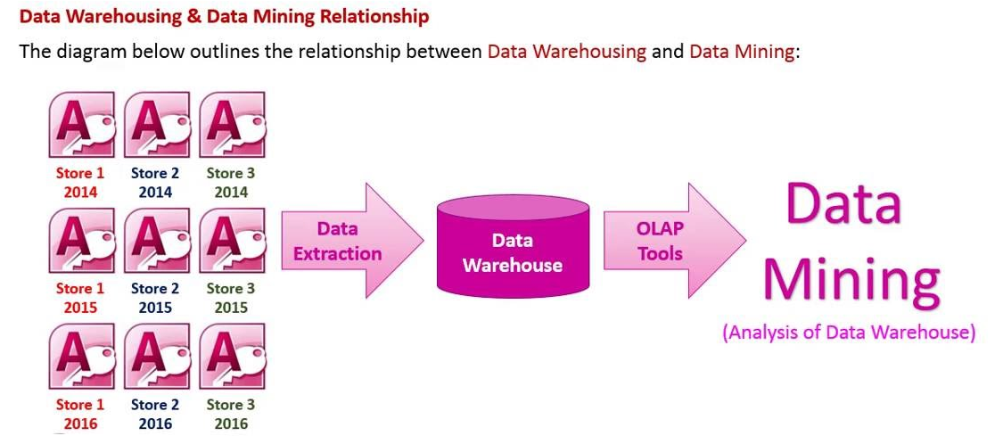
Data Warehouse and Data Mining

Slide 26
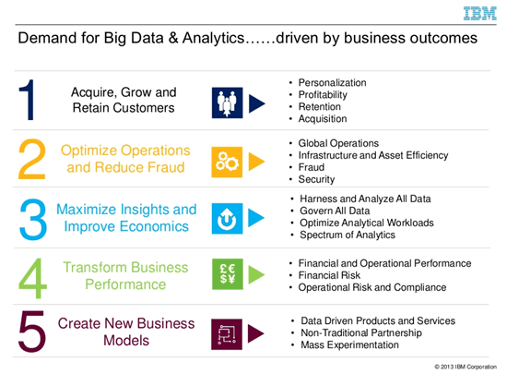

Slide 27
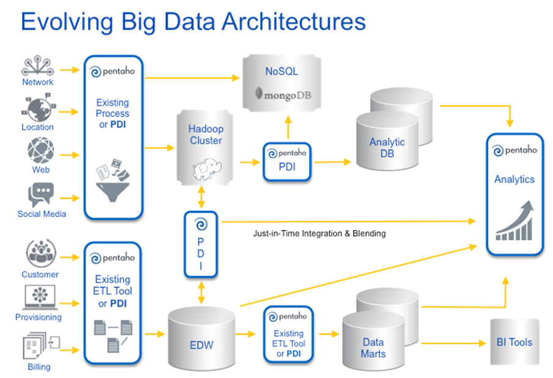

Slide 28
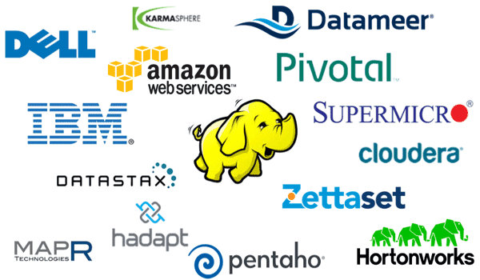
Tools

Slide 29
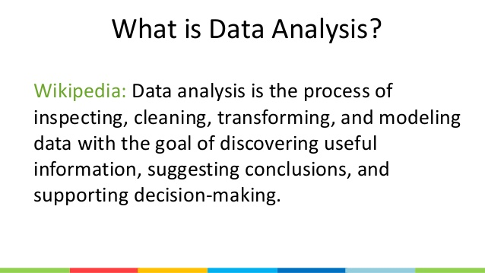
Data Analysis

Slide 30
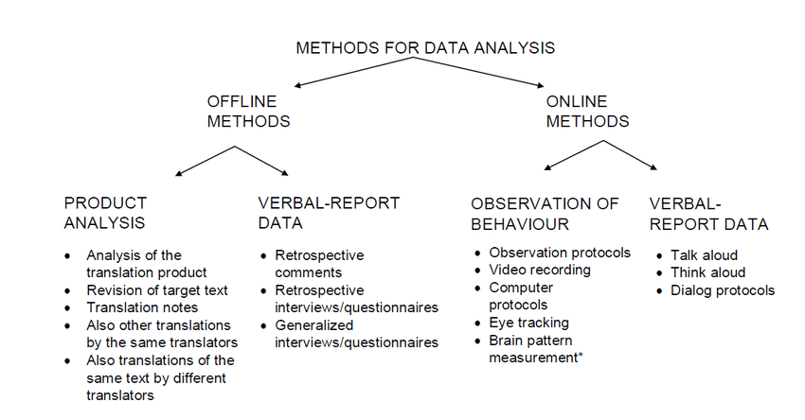

Slide 31
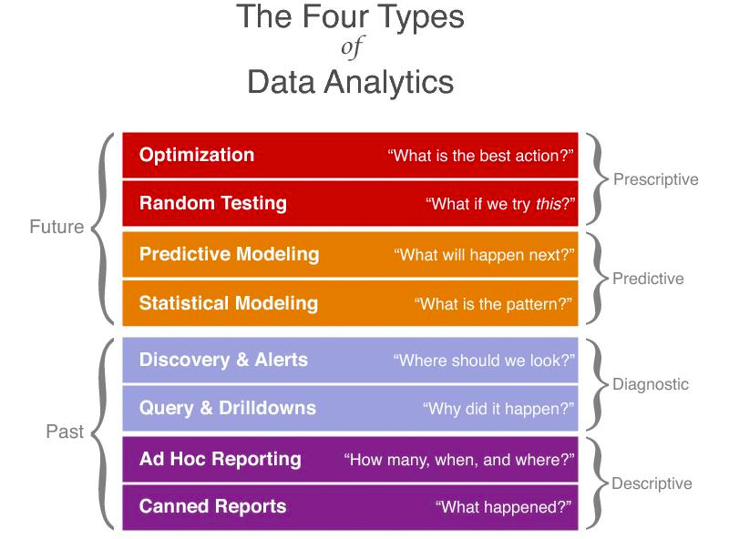

Slide 32
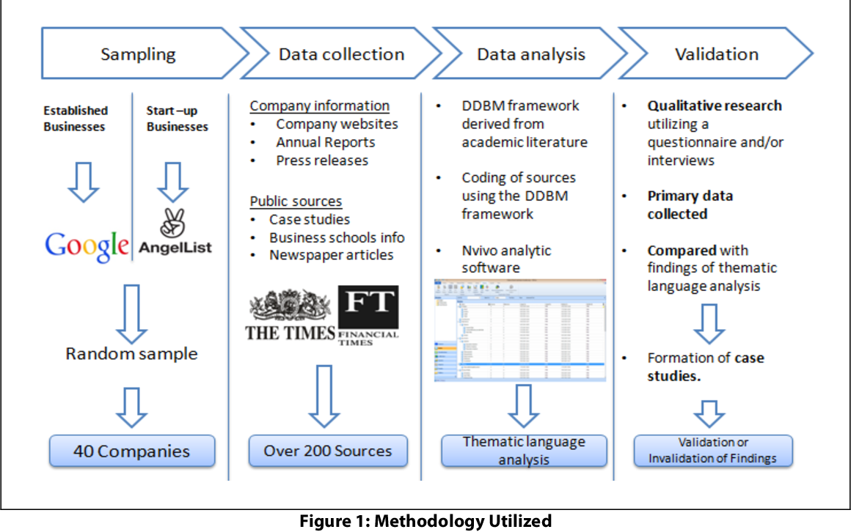
Business Model

Slide 33
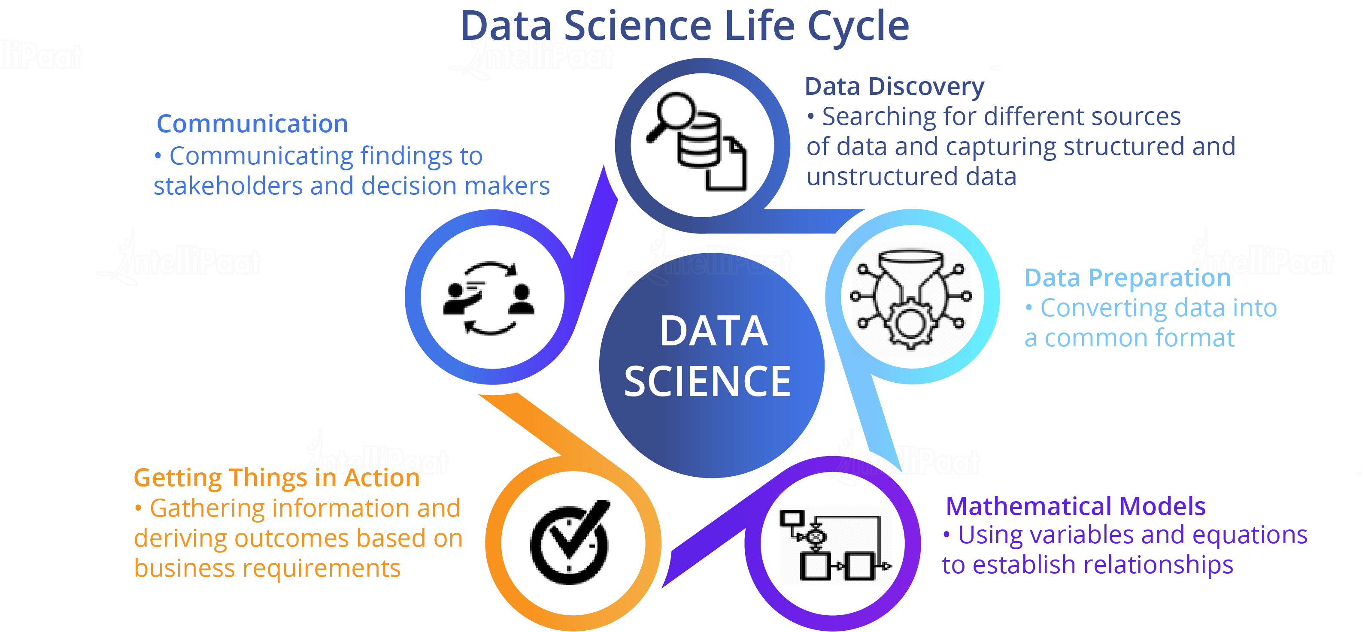
Data Science

Slide 34
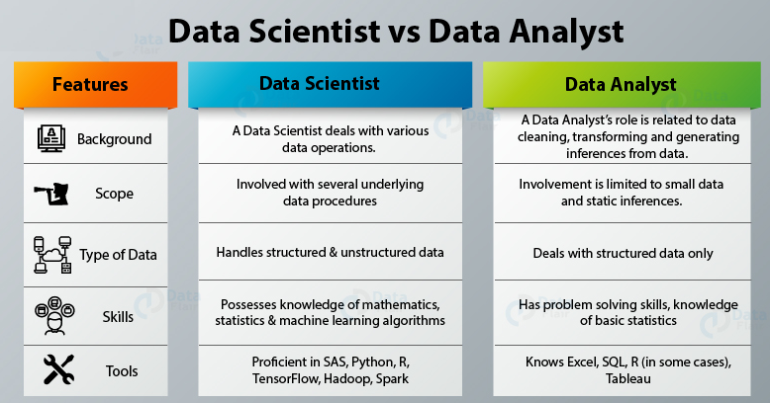
Data Scientist and Analyst

Slide 35
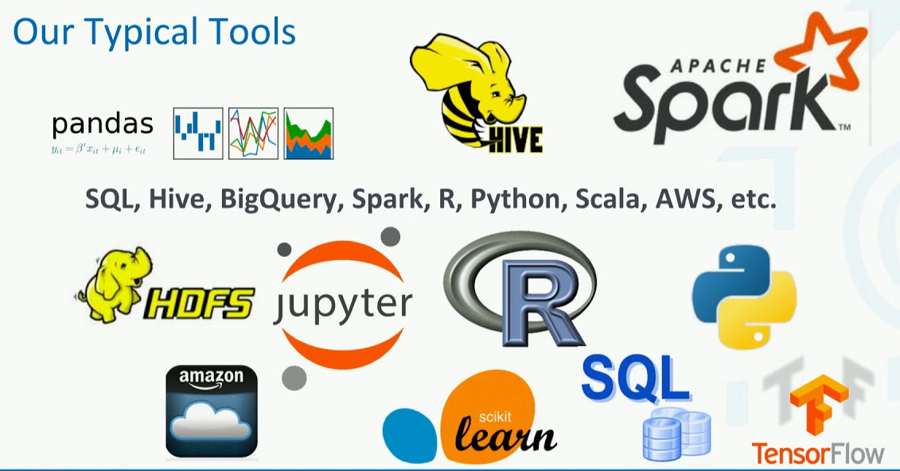
Tools for Data Processing

Slide 36
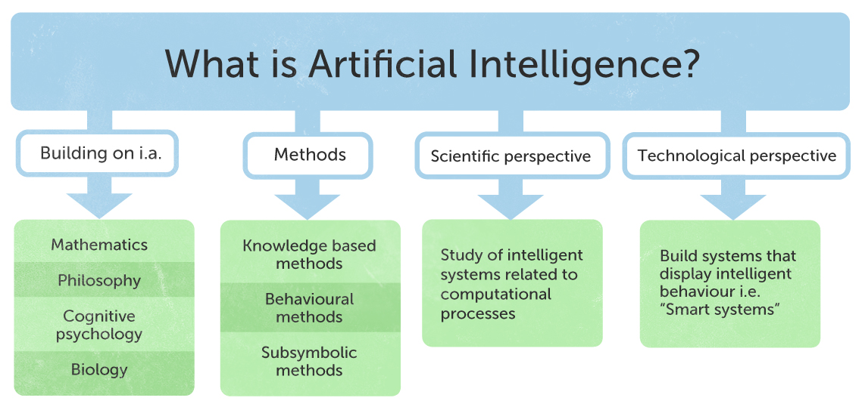
AI

Slide 37
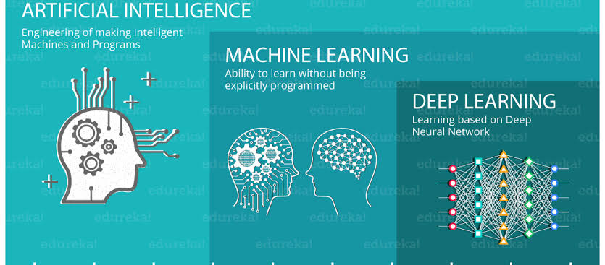
Machine Learning & Deep Learning

Slide 38
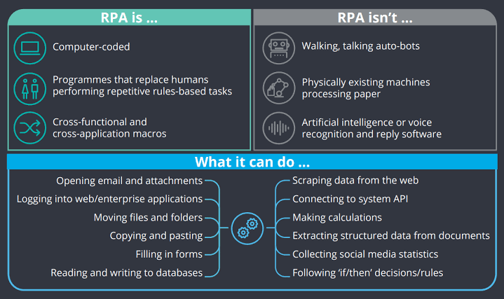
RPA

Slide 39
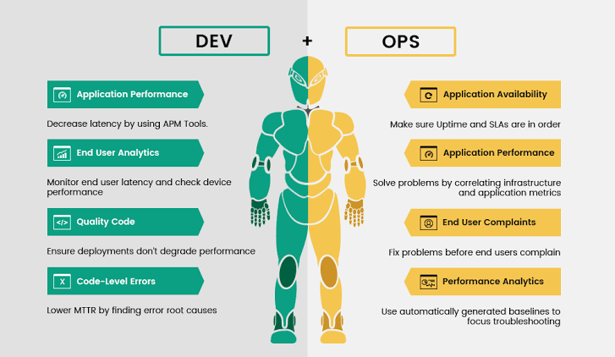
DevOps

Slide 40
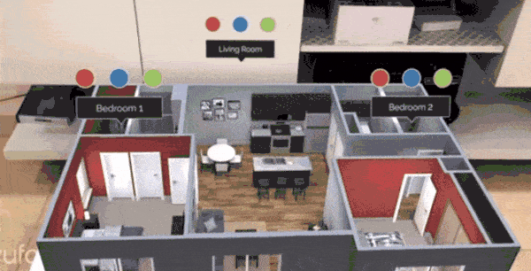
AR VR MR

Slide 41
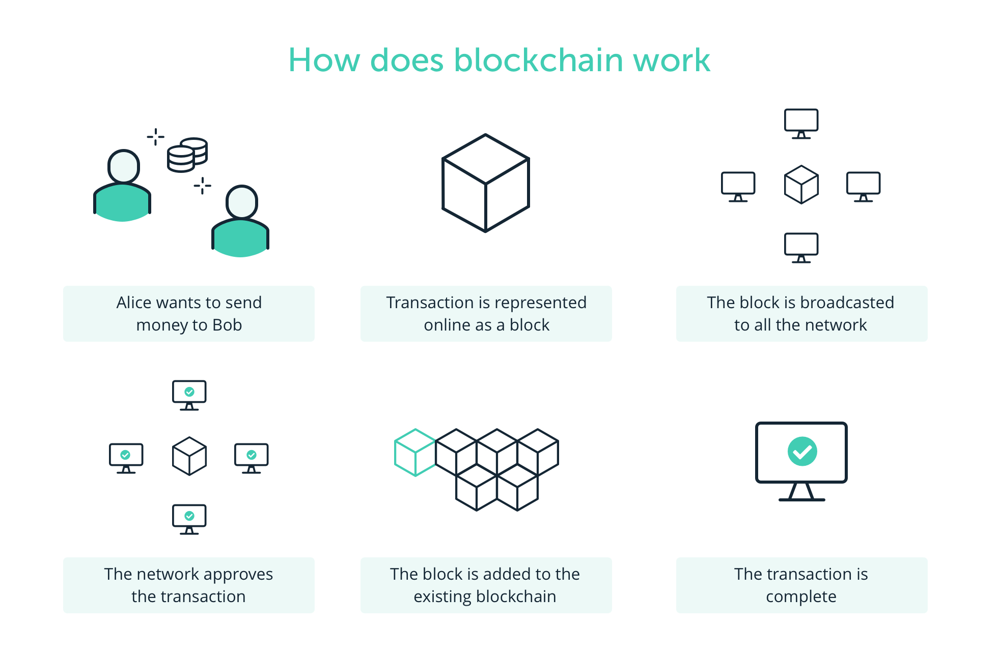
Blockchain

Slide 42
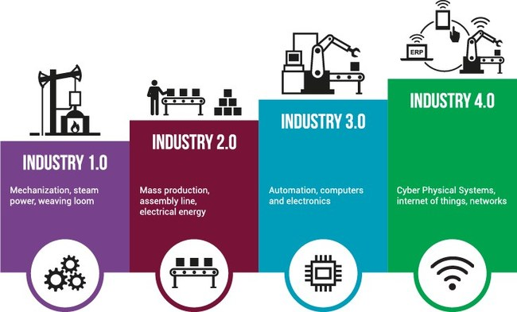
Industry 4.0

Slide 43
Introduction to Cloud Computing Concepts
Module 01

Slide 44
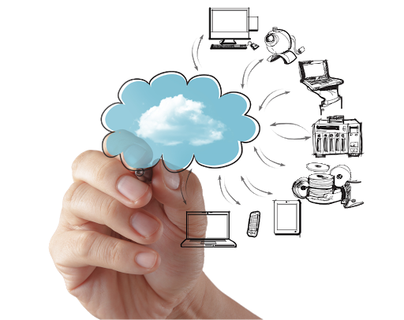
What is Cloud Computing?
Cloud computing is a business computing model that delivers easy-to-use, on-demand network access to a pool of computing resources, including software, infrastructure, and hardware facilities over a network
This "pay-per-use" model helps an organization to use resources when needed and pay only for the facilities and the time for which resources have been used
Hundreds of commercial clouds are available today while Amazon Web Services (AWS), Microsoft Azure, and Google Cloud being the top-most

Slide 45

Benefits of Cloud Computing
Easily access the resources for anywhere and everywhere!
No need for heavy hardware setups and complicated systems
Quickly add or remove additional resources as per requirement
Provides enterprise-level backups for high-end data protection and security
Optimizes maintenance time and cost

Slide 46
Characteristics of Cloud
Rapid Elasticity
Availability
Self-Service viability
Cloud
Measured Service
Broad Network access
Scalability

Slide 47

Virtualization
Virtualization is the process of creating virtual replicas or virtual machines (VMs) of computing resources, by eliminating the traditional one-to-one relationship between a physical server and a logical server
It allows multiple Operating Systems (or multiple instances of the same OS) run on one physical machine simultaneously
Although invented in 1967, virtualization is being popularly used since the last decade

Slide 48
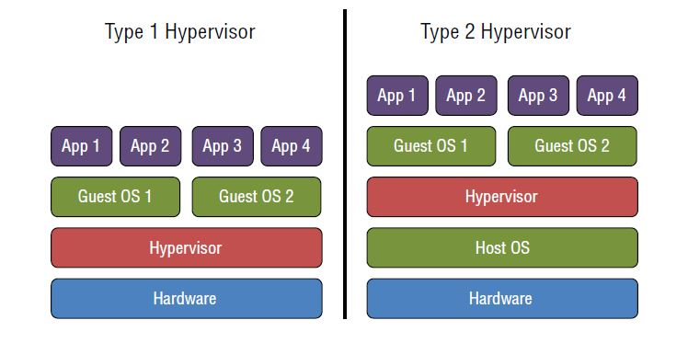
Virtual Machine Manager (VMM)
Widely known as Hypervisor
It is the software that is used to enable Virtualization
There are two types of Hypervisors- Type 1 and Type 2

Slide 49
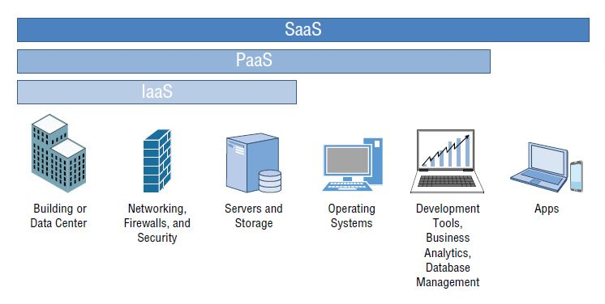
Cloud Service Models
Infrastructure as a service – used for highest-level storage and systems
Platform as a Service – used for managing hardware platforms
Software as a service – used when more applications are involved

Slide 50
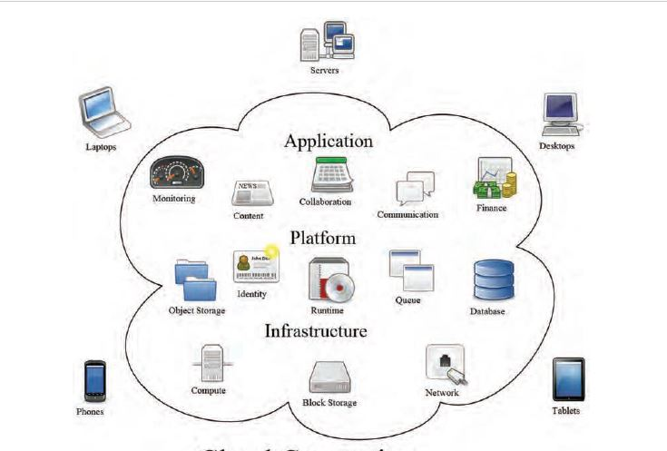
Cloud Service Models (Cont’d)
Here is a glance on how all the 3 service models collaborate:
Source: “Cloud computing” by Sam Johnston. Licensed under CC BY-SA 3.0 via Wikimedia Commons.
Notes:
‘Application’ in the figure represents SaaS

Slide 51
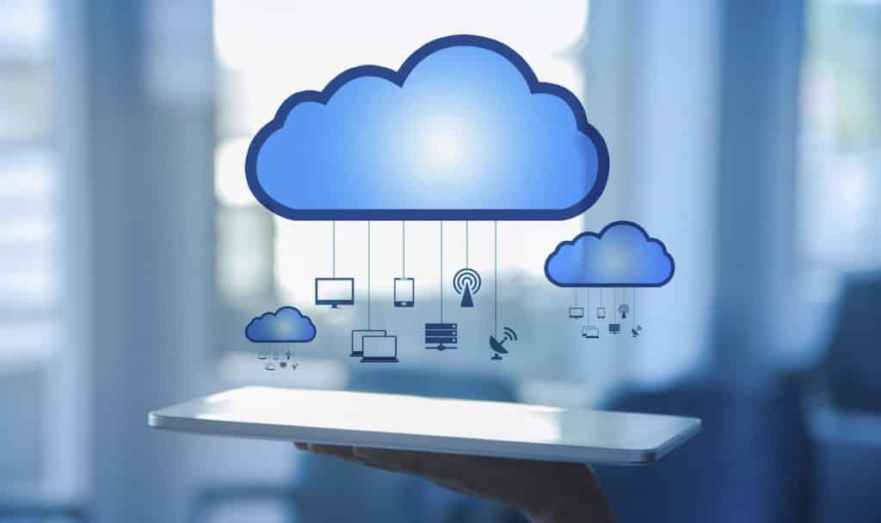
List of other Service Models
Business processes as a service (BPaaS)
Communications as a service (CaaS)
Desktop as a service (DaaS)
Data as a service (also DaaS)
Database as a service (DBaaS)
Disaster recovery as a service (DRaaS)
Functions as a service (FaaS)
Hardware as a service (HaaS)
Information technology as a service (ITaaS)
Monitoring as a service (MaaS)
Network as a service (NaaS)
Anything/everything as a service (XaaS)

Slide 52
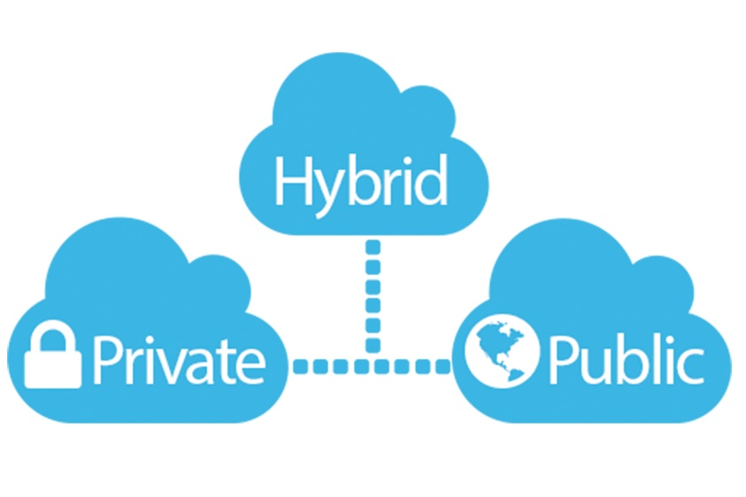
Cloud Deployment Models
Public Cloud – It is a cloud solution that provides dynamically provisioned resources on a self service basis to customers via the Internet
Private cloud – It is a dedicated computing infrastructure owned and shared among users within the organization
Hybrid Cloud – It is a combined application of both public and private cloud services where, the organization stores their critical data in-house and moves the rest of the data to the cloud
Community Cloud – It is a cloud solution in which organizations having common security practices and mission share hosted computing services.

Slide 53
Cloud Security Matters!
Hardware step-up – Done! Virtualization – Done! Shared Service providing – Done! But, what about the security of client’s data ?
Securing the client’s data from viruses and theft is a major challenge of cloud system
Unfortunately, there many hackers out there waiting for that one security hole to breach the precious data
Cloud offers a Shared Responsibility Model, that enables both the client and client service provider to share security duties to improve overall security of the system
In the Shared Responsibility Model:
Cloud Service Provider is responsible for security “of” the cloud
Client is responsible for security “in” the cloud

Slide 54
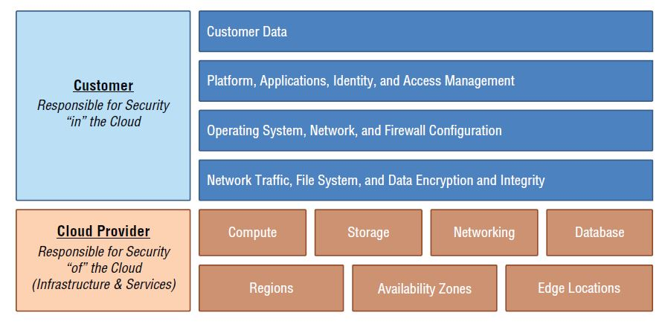
Cloud Security Matters!
The Shared Responsibility Model

Slide 55
Cloud Design Aspects: Redundancy
Cloud is designed in such a way that it always maintains high availability and provides continues access to its resources
Even if there is an unexpected failure in some sort of device, system, or process, then immediately other components of the cloud can take over and provide uninterrupted services to the users
It is important to build a Redundancy Plan with your cloud service provider to eliminate issues caused by a single point of failure
Focus areas to establish a Redundancy Plan are:
Hardware
Network
Geographic locations
Process
Software
Data

Slide 56
Cloud Design Aspects: High Availability
Cloud ensures high availability of services
Availability of cloud services is measured in 9’s (Ex: When some one says “Availability of our cloud is four 9’s “, it means their cloud will be up for 99.99 % of the time)
It is important to discuss about the availability measure with your Cloud Service Provider (CSP), while signing the Service Level Agreement (SLA)
Following shows acceptable down time based on the based on the availability measure
Availability | Downtime per year | Downtime per day
Three nines (99.9%) | 8.77 hours | 1.44 minutes
Four nines (99.99%) | 52.6 minutes | 8.64 seconds
Five nines (99.999%) | 5.26 minutes | 864 milliseconds
Six nines (99.9999%) | 31.56 seconds | 86.4 milliseconds

Slide 57
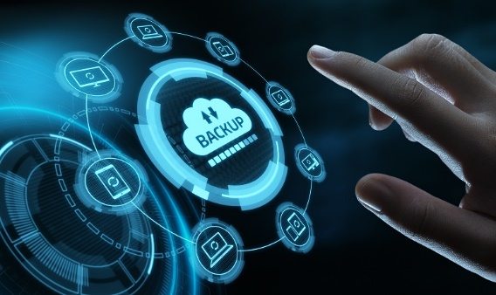
Cloud Design Aspects: Disaster Recovery
Disaster recovery plan is mandatory in any business as it outlines tells how to regain operational status in the event of a disaster
Cloud infrastructure has the ability to become operational after a disaster.
Things needs to be ensured:
All the recovery policies and procedures are clearly mentioned in the SLA
Recovery objectives are defined in a disaster recovery plan
Regular Backups are performed

Slide 58
Cloud Design Aspects: Recovery Objectives
Recovery Objectives
Recovery Point Objective (RPO)
Defines the maximum age of the files that should be recovered
Recovery Time Objective (RTO)
Defines how much time CSP can take to recover everything

Slide 59
Cloud Network and Cloud Storage Technologies
Module 02

Slide 60

Networking Concepts- A Quick Overview
A network is an interface that connects two or more computers or devices and enables them to communicate
Basic elements of network include:
Network adapter (or network card)
Transmission method
Protocol

Slide 61

Networking Concepts- TCP/IP Protocol
Transmission Control Protocol/Internet Protocol (TCP/IP) is a must when we are talking about networking
It is an Internet protocol that enables the communication
TCP/IP has many other internal protocols working automatically in four levels, where every device uses each of these 4 levels for communicating with other devices

Slide 62

Networking Concepts- TCP/IP Protocol
The 4 levels of TCP/IP Protocol:

Slide 63
Connecting to Cloud

Slide 64

Hypertext Transfer Protocol Secure (HTTPS)
Hypertext Transfer Protocol Secure (HTTPS) is responsible for connecting the client to cloud resources
Example: Connecting to Google Drive with HTTPS

Slide 65
Remote Desktop Protocol (RDP)
RDP protocol allows the users to create and access virtual Windows copies of their computers in any other devices
Once the Windows virtual instance is created, the user can access it just like their original server - host and run apps, browse files, provide storage, etc.
These virtual instances are mainly used for:
Creating different test environments
Providing extra server capacity

Slide 66

Remote Desktop Protocol (RDP) (Cont’d)
Once the virtual system is created by the provider, you should install an RDP client on the current device through which you are going to access the virtual system
For example:
Linux users can use the rdesktop command
macOS users can download the Microsoft Remote Desktop app from the Mac App Store
Android and iOS users will find RDP clients in their respective app stores
Whereas, Windows includes an RDP client called Remote Desktop Connection; See here 🡪

Slide 67
The Secure Shell (SSH)
Secure Shells functionality is similar to RDP; the difference is RDP is for Windows Virtual Instances whereas, SSH is for the Linux Instances
SSH allows the client to connect and access the virtual copy of Linux system using another device
Once the connection is established by the provider, You use an SSH command to access the virtual Linux system
Example: (for Ref only)
ssh -i "QDt1.pem" ubuntu@ec2-13-58-100-31.us-east-2.compute.amazonaws.com
You can always use Open Source SSH clients like ‘PuTTY’, if your computer does not have access through SSH commands

Slide 68

Virtual Private Network (VPN)
VPN provides prominent internet traffic security and is widely used for secure traffic between the physical cloud sites
It is defined as secured private connection that occurs through a public network
VPN is very useful for the organizations to secure their employees remote network in this current scenario

Slide 69

Direct Connect
In Direction Connection, the system is physically connect to the network of cloud service provider
This is mostly used when bulk data transfer is needed for large number of systems
Examples:
Azure ExpressRoute
AWS Direct Connect, and
Google Cloud Interconnect

Slide 70

Cloud Storage Technologies
Storage in the cloud functions similar to storage on a local device, the only difference is you need Internet to access the data in cloud’s hard drive!
Cloud storage runs on software-defined storage (SDS)
SDS – A technology that separates the physical storage of data from the logical control over drive configuration, independent from the underlying hardware

Slide 71
Storage Providers
There are many cloud storage providers starting from big to budding players in the business
Here is a list of few cloud-based storage providers:
Dropbox
Apple iCloud
Box
Microsoft OneDrive
Google Drive
Choosing the right storage provider is totally up to your speed Vs. cost requirements

Slide 72
Storage Characteristics
Storage performance categories
Hot Storage
Cold Storage
For Readily Available data
For not-so-used data

Slide 73
Storage Characteristics (Cont’d)
Trait | Hot Storage | Cold storage
Access speed | Fast | Slow
Media type | Solid-State drives (SSDs) | Hard Disk Drives (HDDs), Tape drives
Cost per GB | Higher | Lower
Table: Hot Storage Vs. Cold Storage

Slide 74
Storage Characteristics (Cont’d)
Key Considerations when it comes to storage:
Cost per gigabyte
Storage capacity limits
The maximum number of containers allowed
Data encryption
Storage compression and/or de-duplication
If intelligent analysis of storage usage and/or automated optimization is provided
Dynamic container resizing (e.g., capacity on demand)
Data read/write speed
Number of data reads/writes allowed, or cost per thousand reads/writes
Data latency for reads/writes
Data retrieval time for archives
Archived data retrieval cost

Slide 75
Storage Types
Although data stored inside the hard disk is in binary format (0’s and 1’s); Basic categorization of data storage is done in three types:
Files
Blocks
Objects

Slide 76

Storage Types: Files
Based on filing cabinet
Structure:
Filing Cabinet 🡪 Folders 🡪 (Sub Folders) 🡪 Files
File systems in different Operating systems
Windows - New Technology File System (NTFS)
Macs - Apple File System (APFS),
Linux - fourth extended file system (ext4),

Slide 77

Storage Types: Blocks
Files are split in to equal sized chunks 🡪 assigned to unique ID 🡪 storage in hard drive
Blocks does not need any file structure as they are assigned to a unique ID

Slide 78
Storage Types: Objects
Object type is used to store unstructured data; example pictures and videos
Most of the organizations use object storage to analyze and retrieve their unstructured data effectively
Every unit is stored as an object no matter its type and size
Following are the characteristic of an object:
Data
Meta Data
Object
ID
Attributes

Slide 79
Storage Features
Compression
Makes files smaller to save the storage space
Storage Features
Deduplication
Eliminates duplicate data

Slide 80

Storage Features
CDN balances the load of the original webserver and provides high-speed access to web resources for the users in geographically distributed locations
The main idea behind CDN is to provide uninterrupted services to the users in remote locations
This is how CDN works:
Creates PoP (point of presence) with each having a edge server
Catches content from original web server
Serves remote users

Slide 81
Cloud Assessments and Services
Module 03

Slide 82
Overview: Cloud Implementation Framework
Any Cloud Implementation Framework can be decoded in to five categories:
Gather Requirements
Business, Technical, Key Stakeholders
Assessment
Baselines, Feasibility, Gap Analysis
Design
Define Future State
Implementation
Migration
Operations/ Management
Ongoing Management and Assessment

Slide 83
Cloud Assessments: Step 1: Gathering Requirements
Questions to ask yourself:
Does our business even need the cloud?
What do we need?
Whom to approach for requirements?
Who are the key stakeholders when it comes to cloud?
Key stakeholder is a person involved in your business who has a particular interest or concern in something. Example:
Chief executive officer (CEO)
Chief financial officer (CFO)
Chief information officer (CIO)
Chief technology officer (CTO)
Chief information security officer (CISO)
Department managers or supervisors
Key network and application users

Slide 84

Step 2: Using Baselines
A baseline is a test that is performed to read the performance of network and cloud services
It is important to identify what to baseline and when to baseline
Baselines helps to identify if your business needs any additional cloud services to increase the performance

Slide 85
Step 3: Performing a Feasibility Study
Feasibility study determines the practicality of the proposed requirements
It is mainly performed to determine:
Capabilities that can/should be offloaded to the cloud
Level of cloud availability (The Nines! Remember we discussed in Module 02?)
Compliance, security, and privacy guidelines
Support services from your Internal business and CSP
Migration path to the cloud

Slide 86
Step 4: Analysing the Gaps
A gap is nothing but the step space between where you are and where you want to be in future
There can be cases where your current business requirements might differ from what you need in the next month- Gap analysis is performed to identify all such cases
Following is the sample template used for analyzing Gaps
Category | Current State | Goal | Action Needed | Priority | Owner | Due Date
Business
People
Governance
Platform
Security
Operations

Slide 87

Step 5: Reporting
Reporting and measuring the cloud performing is done based on the following key elements:
Compute
Network
Storage
Reporting not only helps to measure the performance but also to share this data with other core executives in your business, when needed

Slide 88
Step 6: Understanding Benchmarks
While baseline is a read of performance, A benchmark is a point of reference for comparison
Which means, once you get the results from baseline, you can refer to the benchmark and evaluate the cloud performance
Key areas to benchmark while assessing potential CSPs:
Availability
Response time
Incident resolution time

Slide 89

Step 7: Documentation
Documentation is required for keeping everything in track and can be very helpful while:
Meeting with stakeholders
Locating resources and applications during pre- and post-migration
Identifying Owners of capabilities and processes
Identifying Internal and external points of contact

Slide 90
Cloud Services

Slide 91
Identity Access Management
Identity Access Management is used to verify that the person trying to log in and access cloud resources is who they say they are!
IAM Method | Description
Multifactor Authentication | Takes multiple pieces (two or more) of information form the user before they login to ensure high-level security
Single Sign-On (SSO) | Allows users to access all of the systems, resources, and apps with one initial login; by removing the burden of creating different logins for multiple applications
Federated identity management (FIM) | FIM is a SSO across organizations or security domains

Slide 92
Cloud-Native Applications
Agile Cloud based applications run on two technologies
Microservices
Containerization
Applications are broken down into smaller components and work together to form an application
All microservice components are stored the same container to achieve an organized approach

Slide 93
Data Analytics
There is tons of data out there and not everyone knows how to make best use of it! Some of the tools designed to analyze the data include:
Tool | Purpose | Applications
Artificial Intelligence | Designed to make machines think like humans It is programmed in such a way that machine can respond to a stimuli | Virtual Personal Assistants, Video Games, Digital Marketing, Financial and Transport Industries
Machine Learning | Specialized form of AI that takes input and classifies it based on preset categories ML learns an adopts the data provided to it | Image recognition, facial recognition, Speech recognition, Medical diagnoses, Financial modelling, Data extraction, etc.
Digital Marketing | Design to analyze the users interest and market the products based on it using digital platforms | Email Campaigns, Social Media Campaigns

Slide 94
Blockchain
Blockchain is used to record and store the internet-based transactions between the two parties securely
Blockchain mechanism was initially developed for Bitcoin, a widely used digital crypto-currency tool
Now, it is providing services for smart contracts and even supply chain management as well
Principles of blockchain:
Decentralization – Owned by Nobody
Transparency – Can be accessed by anybody
Immutability – Data that is stored cant be changed

Slide 95

Blockchain - Working

Slide 96
Other Cloud Services
Subscription Services
Collaboration
VDI
Self Service
Quite opposite to pay-as-you-go service
Preferred when the client has unpredicted needs
Preferred when the employees of the company are geographically separated
Suits best for the present Work-from-home scenario
Example: Online chat, shared file storage, etc.
Virtual Desktop Infrastructure allows administrator to create a user desktop inside a VM located on a server
VDI is offered as desktop-as-a-service
Do not have a CSP? No worries!
You can always access the additional cloud services automatically anytime-anywhere!
Example: AWS S3

Slide 97
Cloud Migration Approaches
Module 04

Slide 98
What is Cloud Migration?
Migration is the process of relocating organization’s data, services, applications, and workloads to the cloud
This process is performed once you have finalized your cloud service provider and done with signing the necessary contracts, Statement of Work (SOW), evaluation proofs and Service level agreement (SLA)
Based on their business requirements, you can either of the following options:
Migrate everything to one cloud,
Transfer your components to different clouds, or
Keep some elements in an on-premises environment and transfer the rest of them

Slide 99
Migration Principles
Principles for implementing successful migration are:
Identify all the components that you choose to migrate.
Categorize them by size and complexity.
Choose order of Migration
Identify the migration tasks and assign the roles to respective people
Build a Migration Road Map (plan) and establish KPIs
Develop a security plan for pre- and post-migration.
Communicate the migration plan to key stakeholders
Execute the Migration plan
Review the Migration and fix the issues, if any!

Slide 100
Cloud Migration Risks
Complexity Creep
Application Issues
Security Risks
This can occur if your business needs to move heavy and complex systems
All your applications may not be able to adopt to the cloud environment and can generate errors!
Ensure that your CSP and internal security experts maintain high-level data security and privacy
Can also occur when your are opting multi-cloud migration
Also double check for the dependency apps. Meaning – some app are dependent upon another to operate properly
Security is maintained by running continual tests during and after the Migration process

Slide 101
Cloud Migration Approaches
Migration
Methods
Lift and Shift
Rip and replace
Hybrid and Phased

Slide 102
Migration Approach: Lift and Shift
Lift and Shift is a simple approach which literally means picking up all the elements and moving them into the cloud directly
This approach is sometimes refereed as Re-hosting because, the elements of the business will be shifted into a new host
Why to choose Lift and Shift Approach?
Quick and easy
Requires no/very few changes to existing apps
Saves cost on hardware infrastructure

Slide 103
Migration Approach: Lift and Shift (Cont’d)
Lift and Shift can be customized in two other ways, based on the business requirements:
Re-platforming:
Re-factoring
Minor changes are made to the app after it is moved to the cloud in order to help performance
Migrated app is re-programmed to take advantage of cloud features
Less risky
Risky compared to re-platforming
Also known as Re-architecting

Slide 104

Migration Approach: Rip and Replace
You can choose Rip and Replace approach if you want to use only cloud-naïve components and redesign all your applications from scratch
Main idea behind this approach is, to design cloud compatible applications so that no app misses a single feature of cloud and make full use of it
Preferred when migrating an old app or an app that is suffering from performance issues

Slide 105
Migration Approach: Hybrid and Phased Migrations
Hybrid Migration is a combination of the lift-and-shift and rip-and-replace methods
Whereas, Phased Migration is implemented in different phases as shown below:
Cloud Assessment
Proof of Concept/ Value
Data Migration
App Migration
Cloud Usage
Optimization

Slide 106
Cloud Operations
Module 05

Slide 107

Data Management
Be it a structured data or an unstructured one, protecting and managing it is the most important task in cloud
Data in the cloud can be managed using three approaches:
Replication: Data availability
Locality: Location or proximity
Backup: Disaster recovery

Slide 108
Data Management: Replication
Replication provides data redundancy by creating replicas of data
That is, a copy of data is stored in another location so that if one storage location fails, the other location can immediately pick up without the troubling the end user
This whole process is done by the CSP by default and there won’t be any additional costs for this typically
Note that Replication is a recovery option only for loss of infrastructure but not for data deletion
Replication can be done in two ways:
Synchronous
Asynchronous

Slide 109

Data Management: Locality
Locality is the location at which the data is stored in the cloud infrastructure
This location matters as it impacts the data availability to the users; Meaning - how quickly users can access the data from the cloud

Slide 110
Data Management: Backup
Remember we discussed that Replication is a recovery option only for loss of infrastructure but not for data deletion?
Here is where the Backup comes into use - Backup protects the data from intentional/accidental deletions
Cloud service providers offers snapshots as backups that capture all the data on a drive at a point in time and freeze it
Snapshots also help to:
Return a Virtual Machine (VM) to the state of the snapshot
Create a VM copy of the original server

Slide 111
Availability
Cloud providers offer continues availability of their services by building multiple data centers called as Regions
Top CSPs have regions (data centers) all over the globe
Key Terminologies :
Zones
Regions
Geo-redundancy

Slide 112

Availability: Zone
Zone is a data center or a group of data centers that work as a single unit in order to provide uninterruptable services to the end users
Tip: Ensure that your CSP offers a guarantee of the zone availability services in SLA

Slide 113
Availability: Regions
Group of zones becomes a region
Example: List of the public regions offered in North America from AWS and Azure for reference –
US East (N. Virginia)
US East (Ohio)
US West (N. California)
US West (Oregon)
Canada (Central)
East US (Virginia)
East US 2 (Virginia)
West US (California)
West US 2 (Washington)
Canada Central (Toronto)
Central US (Iowa)
North Central US (Illinois)
South Central US (Texas)
West Central US (Wyoming)
Canada East (Quebec City)
AWS
Azure

Slide 114

Availability: Geo-Redundancy
Geo-redundancy offers cross-region availability by replicating services between regions
Content Delivery Network (CDN) implements Geo-redundancy by compromising and replicating specialized servers maintained by the CSP
These specialized servers are referred as edge locations
The edge locations will cache a copy of content and serve it locally from their locations
Whenever the content in cloud is updated , the edge location will make a callback to the source and retrieve up-to-date content

Slide 115

Disposable Resources
Virtual/temporary resources in the cloud are referred as Disposable resources
The concept of Disposable resources increased the use of immutable infrastructure
Examples of disposable resources include: Compute, storage, and network resources

Slide 116

Monitoring and Visibility
CSPs use the following techniques to monitor the cloud deployments automatically
Alerts – Triggering notifications on billing, compute, storage, and networking activities
Logging - Recording events or actions that have occurred against an asset

Slide 117
Autoscaling
Autoscaling is used for sizing resources in the cloud, that is increasing/decreasing the resources in cloud
With the help of Autoscaling, you can set the parameters of an optimal or acceptable performance and have the cloud keep your application within those parameters
Remember that Autoscaling tool must be monitored regularly

Slide 118
Right Sizing
Although CSPs offer two sets of requirements (minimum and recommended) to the clients, they usually suggest to go for recommended to be on a safer side
But, as a buyer it is important for you to recognize and understand what is actually required for you, rather than just going for the recommended
Typically users think, “We have X resources on premises, so we need X resources in the cloud.”/ “we must have the same resources in the cloud because that is the way it has always been done.” – But it is not always true!
Tips for right-sizing:
Consider ONLY recent data
Categorize your environments when right-sizing
Example: Development, testing, and production will have different requirements and give different metrics
Consider time periods that are large enough

Slide 119
DevOps in Cloud Environments
DevOps is the combination of cultural philosophies, practices, and tools that increase an organization’s ability to deliver applications and services at high velocity: evolving and improving products at a faster pace than organizations using traditional software development and infrastructure management processes. This speed enables organizations to better serve their customers and compete more effectively in the market.
To be precise, DevOps is the combination of combination of software development (dev) and IT operations (ops) where, CSPs focus is on the DevOps tools

Slide 120
DevOps in Cloud: Pipeline
Pipeline is used to refer application development and deployment process and is typically categorized into 4 parts:
Development
Build
Test
Release
Example: Classic application development pipeline Vs. Classic application development pipeline

Slide 121
DevOps in Cloud: Pipeline
Classic application development pipeline | Classic application development pipeline
V1.2 Application release: 25 new features and 12 bug fixes | Dev | -> | Build | -> | Test | -> | Release | - 6-month timeline | V1.2.56.7809 Application release: 1 new feature | Dev -> Build -> Test -> Release | - 12-hour timeline
Description: Each part is separated from other | Description: Everyone works together
Disadvantage: One silo are waiting on resources from another silo to complete | Advantage: Priorities are more visible, and they can even be changed from day to day.

Slide 122
Provisioning
Once the goals and resources are set, the CSPs deploy them in the given cloud or Provision
Provisioning the resources is offered as Infrastructure as code (IaC) service
In IaC service, the Iinfrastructure is defined as a code; where -
Infrastructure refers to compute, storage, and networking
Code refers to configuration file(s) that are in form of a structured data set in text format (eg: JSON files)
Benefits of IaC service:
Automates the Infrastructure setup and configuration
Allows you to copy and rebuild the same infrastructure over and over
Enables you to build test environments

Slide 123
Provisioning (Cont’d)
Most CSPs offer templates for provisioning and IaC.
Following is a sample template in JSON format:
"Ec2Instance" : {
"Type" : "AWS::EC2::Instance",
"Properties" : {
"ImageId" : { "Fn::FindInMap" : [ "AWSRegionArch2AMI", { "Ref" :
"AWS::Region" },
{ "Fn::FindInMap" : [ "AWSInstanceType2Arch", { "Ref" :
"InstanceType" }, "Arch" ] } ] },
"KeyName" : { "Ref" : "KeyName" },
"InstanceType" : { "Ref" : "InstanceType" },
"SecurityGroups" : [{ "Ref" : "Ec2SecurityGroup" }],
"BlockDeviceMappings" : [
{
"DeviceName" : "/dev/sda1",
"Ebs" : { "VolumeSize" : "50" }
},{
"DeviceName" : "/dev/sdm",
"Ebs" : { "VolumeSize" : "100" }
}
]
}
}

Slide 124
Continuous Integration/
Continuous Delivery
Continuous integration (CI) is the continuous execution of the first three steps in our application development life cycle: dev, build, and test
Continuous delivery (CD) is the last step in our application deployment pipeline: release
We need to perform Automation in order to achieve both Continuous integration (CI) and Continuous delivery (CD)

Slide 125
Testing in QA Environments
Testing in Quality assurance (QA) environments is the third part of DevOps pipeline
Types of QA Testing:
Sandboxing
Load Testing
Regression Testing
Performed in separate environment that is isolated from other environments
Performed in a User Acceptance (UA) environment
Performed in a both User Acceptance (UA) and dev/test environments

Slide 126
Configuration Management
Both Infrastructure and code has their own configurations and we need a system to manage it
Tools used: SCM and issue tracking
Configuration Management Techniques
Orchestration
Automation
Upgrades and Patching

Slide 127
Configuration Management: Orchestration
Orchestration connects all the automation tasks and works to make it efficient and manageable
Benefits:
Centralized management
Auditing
Runbook
Workflow
Pipeline

Slide 128
Configuration Management: Automation
Automation manages the process by highly automatic means, reducing the human involvement and there by saves a lot of cost!
Example: Automating HR Database; This will help to:
Identify, Monitor and evaluate employee details
Log into the identity management system and create the account employee accounts
create the file share on the required server
Track employee engagement
Perform synthetic login to validate account availability and password

Slide 129
Configuration Management: Upgrades and Patching
Once everything is set and we have all the pieces and parts to deploy our application, its time to upgrade and patch them.
This process is done in two steps
Change Management
Blue/green deployment
Change Management - Process of committing a change that will have an impact on production workload
Blue/green deployment – It suggests - when applying a patch into a production environment, you should deploy into a copy of production and then shift this production load onto the copy, instead of applying a tested patch straight into production

Slide 130
Cloud Security and Risk Management Concepts
Module 06

Slide 131

Threat
Any uncertainty in entity, compute, storage, networking or code that could cause harm is referred as threat
Example: Distributed Denial of Service (DDoS) attack

Slide 132
Vulnerability
Vulnerability is a threat that has not been mitigated
All vulnerabilities are threats, but not all threats are vulnerabilities; the only difference is threads are assigned to specific asset but vulnerabilities are not!
In order to get to know about their vulnerabilities most of the companies use tools like bug bounty, but you can also consider Common Vulnerabilities and Exposures (CVE) database for information on most common vulnerabilities
Largest vulnerabilities in virtualization domain include Meltdown and Spectre
Sources for more info:
Google’s Bug Bounty Project Zero: https://googleprojectzero.blogspot.com/
CVE database: https://cve.mitre.org/cve/

Slide 133
Security Assessments
Security assessment is a systematic evaluation of organization’s security policies and controls
Penetration Testing
Security Assessment
Vulnerability Scanning
Application Scanning

Slide 134
Penetration Testing
Penetration testing is the process of penetrating into the clients network and testing it by the same methodologies and techniques that attackers use
Goal:
Information gathering
Vulnerability exploitation (Ethically)
Types
Internal Penetration Testing
External Penetration Testing

Slide 135
Vulnerability Scanning
Vulnerability Scanning is the process identifying known weaknesses that can be exploited to gain any kind of access
Goal:
To identify potential exploits
Vulnerability exploitation can is done in following Steps:
Tester gains access to the client network
Tries to elevate the privileges in order to exploit the system

Slide 136
Application Scanning
Application Scanning is the process of testing the application for unknown vulnerabilities
Most part of the testing is performed manually in the following steps:
Reviewing the source code
Suggesting the best coding practices
Other than with the manual process, Applications are also tested in three ways: Data, Interface, and Misuse
Data testing is performed by sending data to an application and reviewing how the application responds
Interface testing is performed to test the interface for unintended consequences
Misuse testing is performed to understand how application behaves when something goes wrong

Slide 137
Data Security
Data is the most important asset, One should be more protective about their data – be it personal or work data
identity theft is the major concern now-a-days as it captures and compromises the personal information
Whoever gets hold on the personal information can do malicious activities such as performing a password reset on an email account, sending communications that are disparaging to someone’s character etc. which is scary to imagine!

Slide 138
Data Security: Data Categories
Sensitive
Only management or privileged personnel should have knowledge of the information
Risk Level: HIGH
Private
Only internal personnel is able to view the data
Risk Level: MEDIUM
Public
Anyone can view the data
Risk Level: LOW

Slide 139

Data Security: Confidentiality
Confidentially refers to protecting the valuable assets/data from unauthorized access
Goal of Security mechanisms that offer confidentiality is to:
Prevent confidential data access
Make the asset useless even if the access is achieved
Confidentiality can be maintained by encryption and Sanitization

Slide 140
Data Security: Encryption
It is the process of obfuscating data in such a way that only authorized parties can read it
Types of Encryption – Symmetric Encryption & Asymmetric Encryption
Symmetric Key Encryption
Asymmetric Key Encryption
Same key (a secret key) is used to both encrypt and decrypt electronic information
Also Known as secret-key cryptography
Less secured compared to Asymmetric Encryption
Uses a pair of keys (Public key & Secret key) to encrypt and decrypt electronic data
Also known as Public-key cryptography
Assure high-level secure communication

Slide 141
Data Security: Sanitization
Sanitization can be done in two ways based on the type of data you are dealing with:
Unused data:
Identify the unused data and render it either physically or digitally
Confidential data:
Hide the sections of confidential data before sharing a document to third parties
This process is also known as Redaction

Slide 142

Data Integrity
Integrity is the ability to trust that the data can be acceptable in whatever state it was provided
It ensures that data has not been modified and the identity of a third party can be trusted
Data Integrity can be achieved by validation

Slide 143

Data Availability
Availability means authorized individuals/ applications can access assets in a timely and uninterrupted manner
You can ensure data availability by performing:
Regular Backups
Data Recovery Mechanisms

Slide 144
Application and Infrastructure Security
Not just data, it is also important to secure your applications and infrastructure using necessary tools and practices.
Security Mechanism | Description | Tool
Auditing | This is the process of recording every single important action performed/occurred on organization’s assets | Event Viewer for Windows /var/log directory for Linux SYSLOG servers to record events occurred from Network devices CloudTrail and CloudWatch
Access | Rights or permissions granted/denied by the asset owner | Access Management Console/ Identity Access and Management (IAM)
Authorization | Validates what an asset is and not what it is allowed to do | CloudTrail
Hardening | It is the process of looking at threats against assets and the past events to determine a plan of action for ensuring security | Example: Using Security- Enhanced Linux (SELinux) for Linux system

Slide 145
Risk Management in Cloud

Slide 146
Risk Assessment
IT risk refers to the impacts that cloud occur to an organization’s assets and its stakeholders as a result of a threat exploiting a vulnerability
The probability of IT risk in high in current scenario as everything became digital now, even the interactions between the employees
Assessing the risk is done in two ways:
Quantitative RA
Assigns a monetary value to the elements of risk or the assets themselves
Risk Assessment (RA)
Qualitative RA
Ranks the threats based on experience, intuition, or a specific scenario

Slide 147
Risk Response
Risk Response is the process of determining the actions and developing strategies to reduce threats
Each response is analyzed by a particular team to determine the plan of action. Usually these responses are categorized into four types:
Mitigation
Process of reducing the risk by investing all the organizational resources
Acceptance
Determines how the organization is going to handle the risk
Avoidance
Process of eliminating the probability of risk occurrence
Transfer
Process of transferring all the organizational risk a third party

Slide 148

Organizational Risks
Security challenges include:
Difficulty knowing where data is stored
Technical failures that could destroy the stored data
Issues around data retrieval if a cloud provider goes out of business
Unauthorized access of data by others

Slide 149

Vendor Lock-In
Vendor Lock-in is refereed as the inability/discomfort of the customers to change their decision about the CSP once the Service agreement is signed
This situation occurs if/when Consumers face many challenges that arise concerning data, application and service portability issues

Slide 150

Loss of Management Control
Loss of management control happens when:
Risk factor is high for IaaS provider
Risk factor is low for SaaS provider

Slide 151
Documentation
Documentation not only acts as a guide but is also important for prove compliance (which we are going to discuss in next module!)
When it comes to risk documentation, we talk about the Findings – The documentation on investigation process of a risk event
Typical Investigation Types are:
Criminal
Civil
Regulatory
Operational
If some information in Findings changes/warns a new uncertainty, then you might need to enter it in the risk register

Slide 152
Policies, Procedures and Governance
Module 07

Slide 153
Standard Operating Procedures
SOP Procedures are well-defined steps that an organization follows whenever an event occurs
SOP is not just restricted to risk events, it can also be applied for appropriate for day-to-day organizational activities
To understand the importance of SOP, consider the following example:
An event X has occurred:
Q1: What led up to the event X to occur?
Ans: Programmer made changes to the Application.
Q2: What are is the list of changes made?
Ans: Change1, change2, change3.
Q3: Did they follow SOP?
Q3 says how important it is to follow SOP

Slide 154
Change Management
Change management is the process of approving and managing approved changes to organization’s assets
It is important to understand that any change is going to have an inherit risk and this should be counterbalanced by an increased value to the organization
So, it is not recommended to make changes if
There are no security patches,
No new features, and
No enhancements to the application/ Infrastructure
Note: ITIL identifies best change management practices for an organization to increase availability. It the 1980s by the UK government as a framework for technology adoption

Slide 155

Resource Management
Resource management is the process of managing storage, compute, and network of the cloud
CSPs manage the cloud resources through resource groups
A resource group is the collection of similar resources
CSPs also offers mobile device management (MDM), both for iOS and Android as a part of resource management.

Slide 156
Security Policies
A security policy is foundational policy that every organization decides to adopt
Following are the three different types of security policies
Category | Description
Regulatory | Security policy that is required by either law or regulation
Advisory | Defines behaviors and activities that are acceptable in the organization
Informative | Provides reasoning and/or information about goals and mission statements for the organization

Slide 157
Access and Control Policies
Access and control policies are used to define the security requirements and manage the individuals ability to Read-Write-execute the assets
Their Major focus is CIA (confidentiality, integrity, and availability)
Access and control policies offer three types of controls
Access Control | Purpose | Example
Preventive | Attempts to block or prevent any security events from occurring | penetration testing
Detective | Controls that detect when a security event occurs | Audit trails, Security cams
Corrective | Controls that return assets to a normal operating state after a security event occurs | Anti-malware, backup and restore

Slide 158
Communication Policies
Communication polices deals with professional communications that happen after a security event occurs
These comes into play, as most of communications need to follow law or regulation standards, for example - The federal laws mandate disclosure or reporting of events only involve financial records
Always ensure there are defined communication policies when utilizing the cloud, in the sense-
The policies need to describe who, what, when, and where should be communicated after an event
There should be a catchall communication policy to address unknown or unforeseen events when they occur

Slide 159
Compliance and their Importance
CSPs must define compliance as it allows the end users to raise their concerns and makes them feel confident before signing the contract
With the compliance management CSPs can validate themselves against complaint requirements and regulations
Typically compliance with regulations fall into one of the following three areas:
Activity logging and auditing
Encryption and key management
Identity access and control

Slide 160
Regulatory concerns
Regulatory Concerns
Local, state, and federal regulations
Industry-based requirements
International standards
As it is almost impossible to cover all the regulatory concerns, we will be listing the most popular ones in the next slides

Slide 161
Regulatory concerns (Cont’d)
Local, state, and federal regulations:
Federal Risk and Authorization Management Program (FedRAMP)
Federal Information Security Management Act (FISMA)
Federal Information Processing Standard (FIPS)

Slide 162
Regulatory concerns (Cont’d)
Industry-Based Requirements
Family Educational Rights and Privacy Act (FERPA)
Financial Industry Regulatory Authority (FINRA)
Gramm-Leach-Bliley Act (GLBA)
Health Insurance Portability and Accountability Act (HIPAA)
Motion Picture Association of America (MPAA)
Sarbanes-Oxley Act (SOX)

Slide 163
Regulatory concerns (Cont’d)
International Standards:
CIS Benchmarks
International Organization of Standardization (IOS)
ISO 9001 – Global Quality Standard
ISO 27001 – Security Management Controls
ISO 27017 – Cloud Specific Controls
ISO 27018 – Personal Data Protection

Slide 164
Summary

Slide 165
Questions

Slide 166
Thank You!

